Slide 1
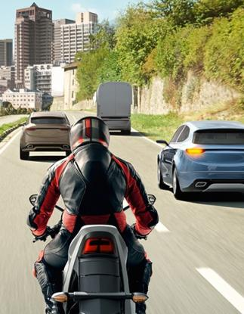
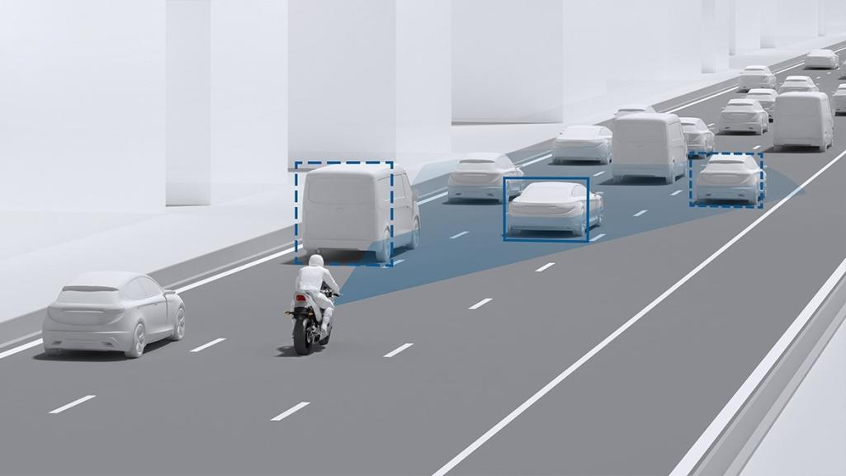
AI Based obstacle prevention tool (Ai-opt)
Outline
TEAM MEMBERS:​
S.J SUMANTH(2010030377)​
CH. SHRAVAN(200030536)​
E. PAVAN SAI(2010030538)​
E. SHIVA GOUD(2010030542)
​
Introduction
References
Literature Review
Problem Statement and Objectives
Proposed Methodology

Slide 2
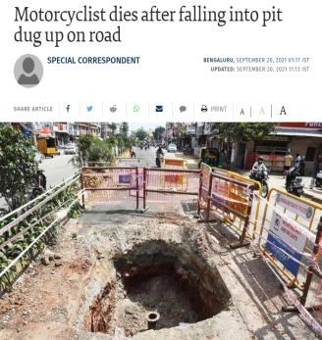
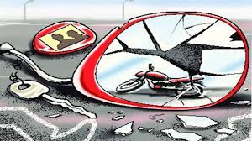
Outline
In India, every year nearly 4 to 5 lakh accidents happen .In those accidents almost 2 to 3 lakh people die.
Many of these accidents happen due to reasons like obstacles on the road and low visibility during night.
These minute human errors are making such huge losses to the society.
1
2
3
4
5
Introduction
Literature Review
Objectives
Proposed Methodology
References

Slide 3
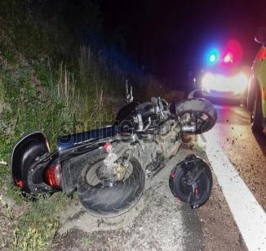
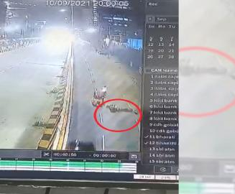
Introduction
In India, every year nearly 4 to 5 lakh accidents happen .In those accidents almost 2 to 3 lakh people die.
Many of these accidents happen due to reasons like obstacles on the road and low visibility during night.
These minute human errors are making such huge losses to the society.

Slide 4
Introduction
S.NO | Author | Journal | Algorithm | Accuracy | Scope
1 | Zhongmin Liu Zhicai Chen Zhanming Li Wenjin Hu | Hindawi | YOLOv2, Y-PD, Faster R-CNN , Yolo v3, Non-maximum suppression algorithm | 90.9% | Because of the diversity of size, resolution and so on, there is still a big gap between our model and the state-of-art pedestrian methods. So future task will mainly work on designing of the better model of the Caltech dataset for pedestrians.
2 | Shrinath Oza , Dr. Sunil Rathod | IJERT | Haar Cascade algorithm Viola jones algorithm YOLO Algorithm DCNN Algorithm CNN Algorithm | 80% | The main purpose of the system is to implement the real-time objects detection system on a Raspberry Pi to avoid accidents and improving road safety.
On a survey about two-wheeler road accidents , we came to know that major percentage of accidents happen at nighttime.
Most of these accidents were led by pits, sand, rocks and other obstacles on the road.
Due to low visibility at nighttime these obstacles can’t be spotted by the rider.
There is no existing technology for alerting the rider in above scenarios.
So, we wanted to explore this problem through object detection.
3 | Mukesh Tiwari, Dr. Rakesh Singhai | International Journal of Computational Intelligence Research | SURF (Speeded Up Robust Features)algorithm | 89% | Future work includes of enhancing the images using different algorithms.

Slide 5
Literature REVIEW
S.NO | Author | Journal | Algorithm | Accuracy | Scope
1 | Zhongmin Liu Zhicai Chen Zhanming Li Wenjin Hu | Hindawi | YOLOv2, Y-PD, Faster R-CNN , Yolo v3, Non-maximum suppression algorithm | 90.9% | Because of the diversity of size, resolution and so on, there is still a big gap between our model and the state-of-art pedestrian methods. So future task will mainly work on designing of the better model of the Caltech dataset for pedestrians.
2 | Shrinath Oza , Dr. Sunil Rathod | IJERT | Haar Cascade algorithm Viola jones algorithm YOLO Algorithm DCNN Algorithm CNN Algorithm | 80% | The main purpose of the system is to implement the real-time objects detection system on a Raspberry Pi to avoid accidents and improving road safety.
Our survey on two-wheeler road accidents revealed a significant problem – 60% of incidents occur at night due to obstacles like potholes, rocks, and sand. The challenge lies in low visibility, making it hard for riders to spot these hazards. Surprisingly, there's no existing technology to address this issue. We plan to tackle it through advanced object detection, developing a system to alert riders to potential dangers in real-time, especially during nighttime.
3 | Mukesh Tiwari, Dr. Rakesh Singhai | International Journal of Computational Intelligence Research | SURF (Speeded Up Robust Features)algorithm | 89% | Future work includes of enhancing the images using different algorithms.

Slide 6
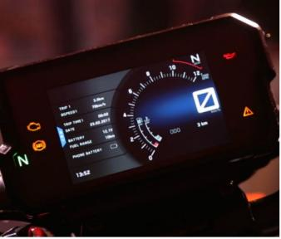

OBJECTIVES
The main objective of this project is to develop an effective and reliable object detection system for vehicles to identify obstacles such as sand piles, pits, and rocks.
The secondary objective is to enhance the user interface to convey information about the detected obstacles. (Implement a text message display on the speedometer and voice command)

Slide 7

Proposed methodology

Slide 8
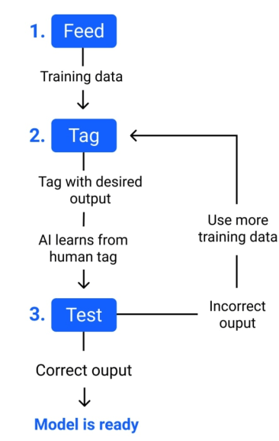
STEP - 1: Training Our Model
FLOW
Training Our Model
Take the real-time inputs
Image Enhancement
Detection and Output
We will use Yolo-v8 model for our project. Here we will be training our model by providing proper datasets.
1. Feed - To input data for training our machine learning model.
2. Tag - Name the training data with a desired output. The model transforms the training data into text and vectors (numbers that represent data features).
3. Test - To test the model using new inputs .If it gives correct output the model is ready. If not train the model with few more datasets.

Slide 9
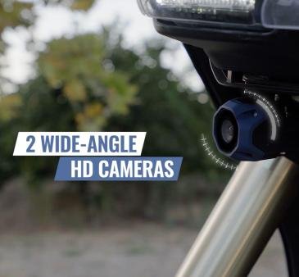
STEP - 1: Training Our Model
STEP - 2: Take the real-time inputs
We will use Yolo-v8 model for our project. Here we will be training our model by providing proper datasets.
1. Feed - To input data for training our machine learning model.
2. Tag - Name the training data with a desired output. The model transforms the training data into text and vectors (numbers that represent data features).
3. Test - To test the model using new inputs .If it gives correct output the model is ready. If not train the model with few more datasets.
The input is captivated from a camera fixed to the bike headlight.
The camera used will be a 4k resolution wide angled camera for better results.
We will capture as many images as possible for a greater accuracy.

Slide 10
STEP - 2: Take the real-time inputs
STEP - 3: Image Enhancement
The input is captivated from a camera fixed to the bike headlight.
The camera used will be a 4k resolution wide angled camera for better results.
We will capture as many images as possible for a greater accuracy.
The image will be received by the Raspberry pi attached to the camera.
As the pictures are taken at nighttime, to enhance the clarity some changes are made like increasing brightness , contrast, adjusting saturation.
RETINEX ALGORITHM: The aim of Retinex-based algorithms is to estimate the right illumination image or reflectance image from its degraded image by different filters to achieve low brightness enhancement.

Slide 11
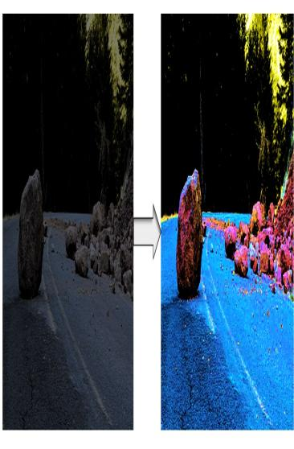
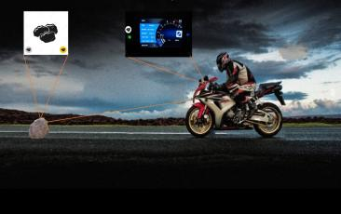
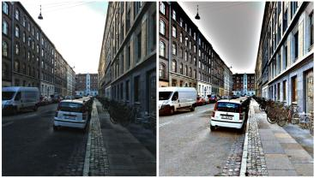
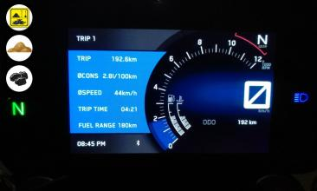
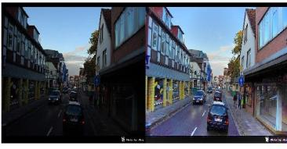
STEP - 3: Image Enhancement
STEP - 4: Detection and Output
For object identification and detection, we will be using Yolov8 algorithm.
The output will be in the form of a logo and a voice command.
The logo will be displayed on the speedometer.
The voice command will be passed on the rider’s helmet via Bluetooth.
The image will be received by the Raspberry pi attached to the camera.
As the pictures are taken at nighttime, to enhance the clarity some changes are made like increasing brightness , contrast, adjusting saturation.
RETINEX ALGORITHM: The aim of Retinex-based algorithms is to estimate the right illumination image or reflectance image from its degraded image by different filters to achieve low brightness enhancement.

Slide 12
STEP - 4: Detection and Output
For object identification and detection, we will be using Yolov8 algorithm.
The output will be in the form of a logo and a voice command.
The logo will be displayed on the speedometer.
The voice command will be passed on the rider’s helmet via Bluetooth.
1. An Efficient Pedestrian Detection Method Based on YOLOv2
2. Accident Avoidance and Improving Road Safety with use of Raspberry Pi for Object Detection
3. A Review of Detection and Tracking of Object from Image and Video Sequence

Slide 13
References
1. An Efficient Pedestrian Detection Method Based on YOLOv2
2. Accident Avoidance and Improving Road Safety with use of Raspberry Pi for Object Detection
3. A Review of Detection and Tracking of Object from Image and Video Sequence

Slide 14
